Slide 1


FinSite
A dynamic expenses tracking application for modern financial wellness​

Slide 2


Contents
01
Abstract
Introduction
Objectives
Literature Survey
Existing system
Proposed system
System requirements
System architecture
Tools
Class diagrams
Sample code
Output
Conclusion
References
02
03
04
05
06
07
08
09
10
11
12
13
14
1

Slide 3

Abstract
FinSight revolutionizes personal finance management by combining the power of React, JSP-Servlets, and J2EE to offer an unparalleled user experience. With its user-centric design, FinSight provides an intuitive interface that simplifies financial oversight. Users benefit from real-time insights, customizable expense tracking, and sophisticated dashboards for a comprehensive view of their financial health. The platform’s integration with JDBC and MySQL ensures robust data handling, while Fetch-api facilitates seamless interaction with financial services. Hosted on a TomCat-Server, FinSight stands out for its engaging visuals and ease of use, empowering users to take charge of their finances and achieve their financial goals with confidence.
Key words: React, JSP-Servlets, J2EE, JDBC, MySQL, Fetch-api,TomCat-Server.
2

Slide 4
Introduction
Revolutionizing Personal Finance Management: Our innovative solution, FinSight, redefines the way individuals manage their finances by offering a comprehensive suite of features tailored to modern needs.
Extensive Expense Category Coverage: From everyday essentials like groceries and utilities to specialized categories such as E-items and kids' toys, FinSight ensures no expense goes unnoticed, providing users with a holistic view of their financial landscape.
Commitment to Inclusivity and Detail: Setting itself apart, FinSight caters to the diverse needs of users by incorporating specialized expense categories, demonstrating a meticulous approach to personal finance management that prioritizes inclusivity and user satisfaction.
Empowering Financial Control: With FinSight, users can effortlessly navigate their financial futures, gaining insights and control over their spending habits with ease. Experience the power of FinSight today and take charge of your financial journey like never before.
3

Slide 5
Objectives
To empower users with comprehensive tools for managing personal finances.
Enhance transparency and collaboration through comprehensive reports and data export.
Facilitate seamless integration with other financial services.
To provide a customizable and intuitive platform for tracking expenses across categories.
Providing Best Ui/Ux interfaces to make app more effective and responsive.
4

Slide 6

Literature Survey
Title : “Financial Wellness Tracking Application with MERN Stack”
Authors : Janga Divya
Published in : IEEE EDUCON 2010 Conference
Abstract : This research paper presents the development and deployment of a web-based expenditure tracking system using the MERN (MongoDB, Express.js, React, Node.js) stack. The project aims to address the growing need for effective personal financial management solutions in today's digital era. The paper discusses the importance of expense monitoring in personal financial management and emphasizes the benefits of web-based tools for this purpose. It outlines the project's technological architecture, highlighting the use of Express.js and Node.js for building reliable financial data storage, and MongoDB as the database.
Keywords: MERN stack, expense tracking, financial management, web based tools
5

Slide 7
Literature Survey
Title : “Financial Self-regulation: Expense-Tracking's Influence on Financial Behaviour”
Authors : Yiling Zhang, University of Wisconsin-Madison
Abstract : This study explores how expense-tracking serves as a self regulatory behaviour within financial self-regulation. It addresses gaps in existing literature by examining expense-tracking beyond budgeting and in real-world contexts. Drawing on self-regulation and mental budgeting theories, the study hypothesizes that expense-tracking informs financial behaviours by evaluating spending alignment with goals and facilitating goal adjustments. Financial self-awareness is proposed as a mediator between expense-tracking and behaviour change. Two studies are conducted, revealing associations between expense-tracking and reduced discretionary spending, increased budget flexibility, and improved saving decisions.
Keywords: financial self-regulation, expense-tracking, financial behaviour, self-awareness, budgeting.
6

Slide 8

Existing System
Inadequate Expense Management:​ Traditional expense management often involves error-prone, time-consuming human record-keeping, hindering comprehensive financial understanding and budgeting.
Data Security Issues: ​Financial data handling poses security risks, leaving user data vulnerable to breaches without sufficient safeguards.
Inadequate User-Friendly Solutions:​Many existing cost monitoring programs lack a simple and user-friendly interface, making them less appealing and more difficult to use for a broader user base.​
7

Slide 9
Proposed System
The proposed features and enhancements for the expense tracking application include advanced dynamic visualization tools such as interactive charts and graphs to offer real-time insights into users' spending habits and progress towards financial goals. Personalized goal-setting mechanisms will allow users to define specific objectives, with the application providing tailored recommendations and strategies for achieving them efficiently.
Behavioral nudges will be integrated to prompt positive financial choices through personalized alerts, reminders, and incentives. Leveraging React.js and D3.js libraries, the application will boast a responsive user interface and rich data visualizations. Backend development will utilize JSP and JDBC for secure data management, while a collaborative dashboard feature will facilitate collective expense tracking among multiple users.
These enhancements aim to provide users with a comprehensive financial management tool that empowers them to make informed decisions, achieve their goals, and enhance their financial well-being.
8

Slide 10

System
Requirements
System: intel i3/i5
Hard Disk: 512 GB
RAM: 8GB
9

Slide 11
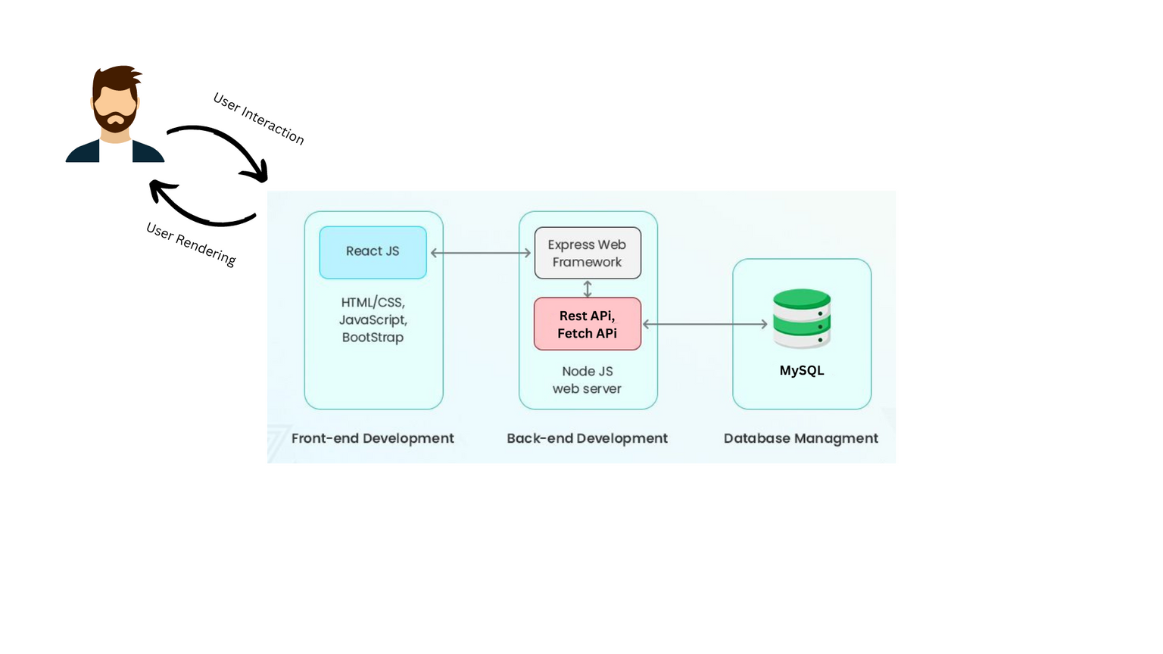
System Architecture
10

Slide 12





Tools
MERN Stack
SQL (Database Management)
HTML/CSS, JavaScript
Java Server Pages
11

Slide 13
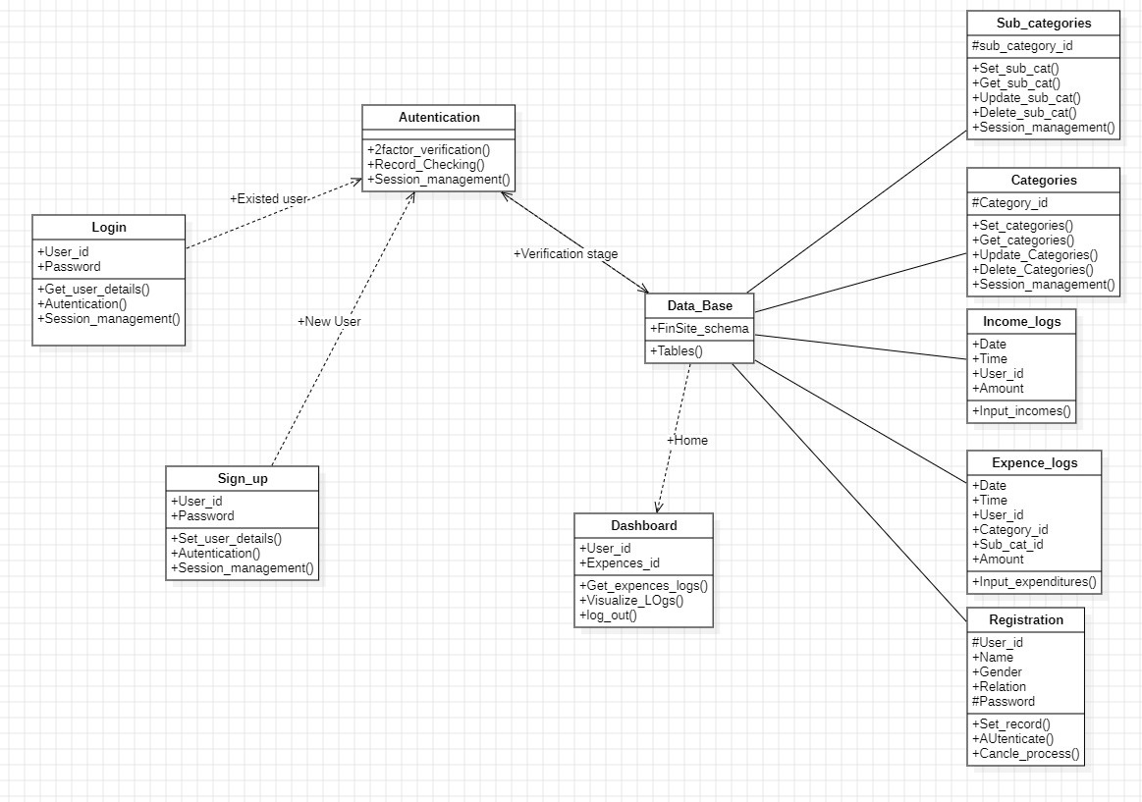
Class Diagram
12

Slide 14
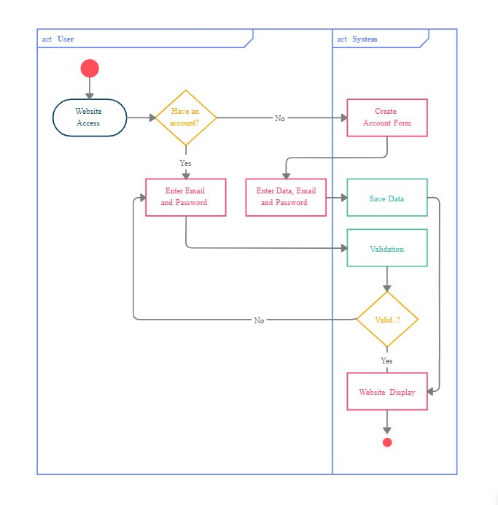
Activity Diagram
For Sign-in/up page
13

Slide 15
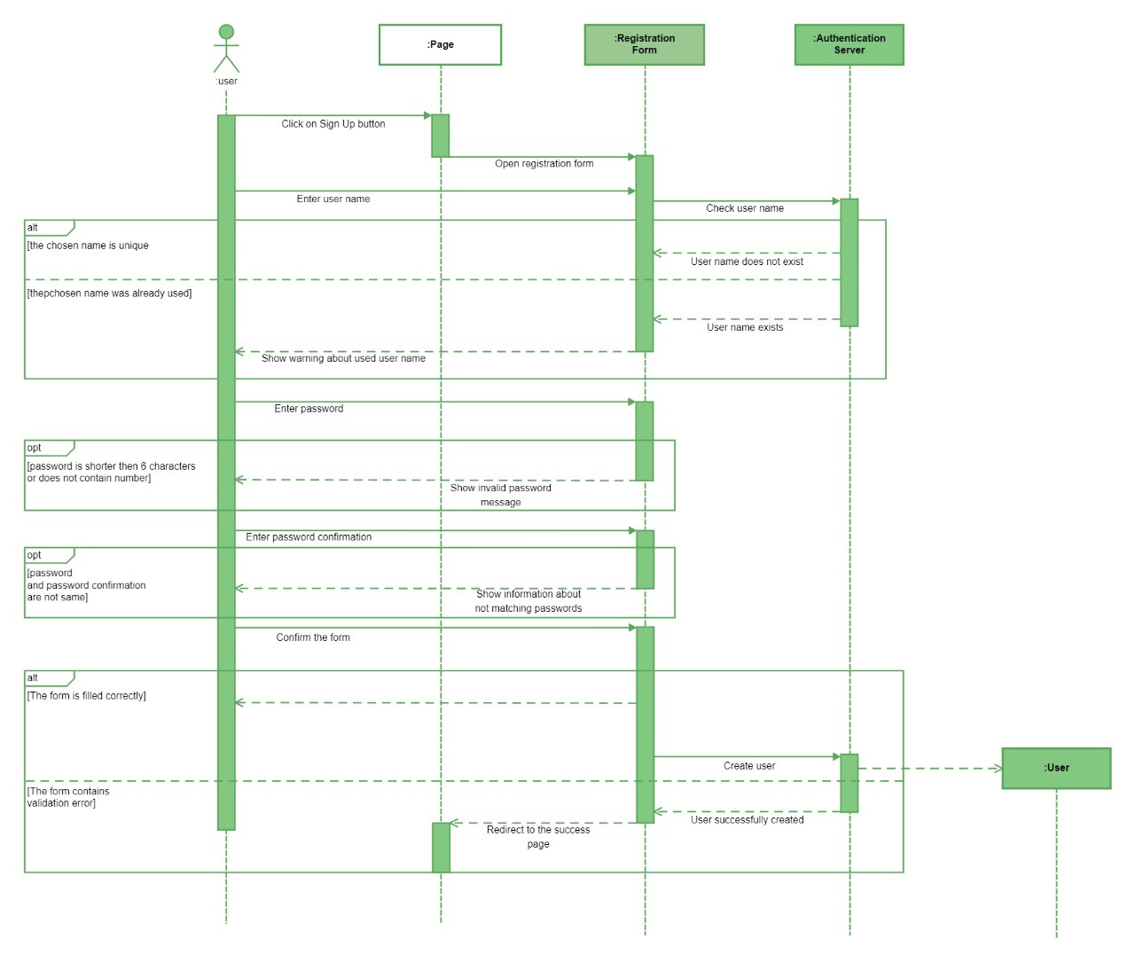
For Sign-in/up ,backend flow
Sequence Diagram
14

Slide 16
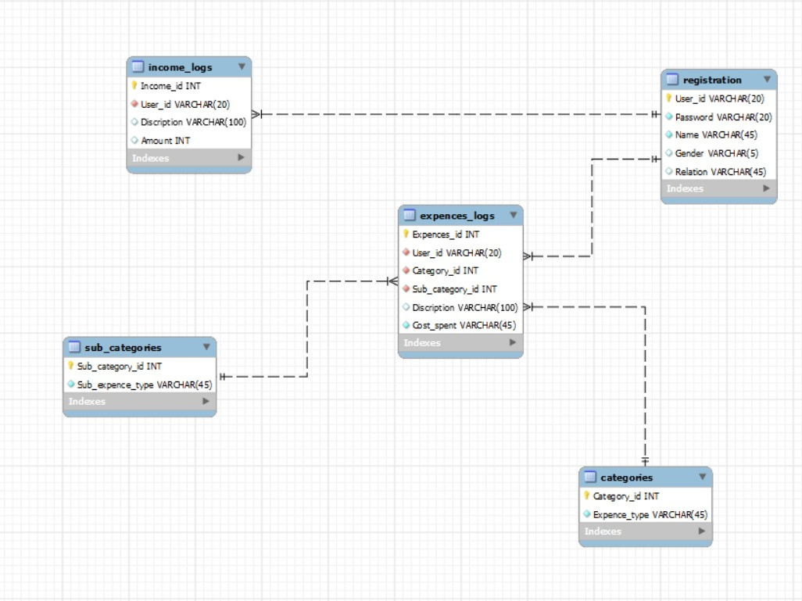
Data Base Schema
15

Slide 17
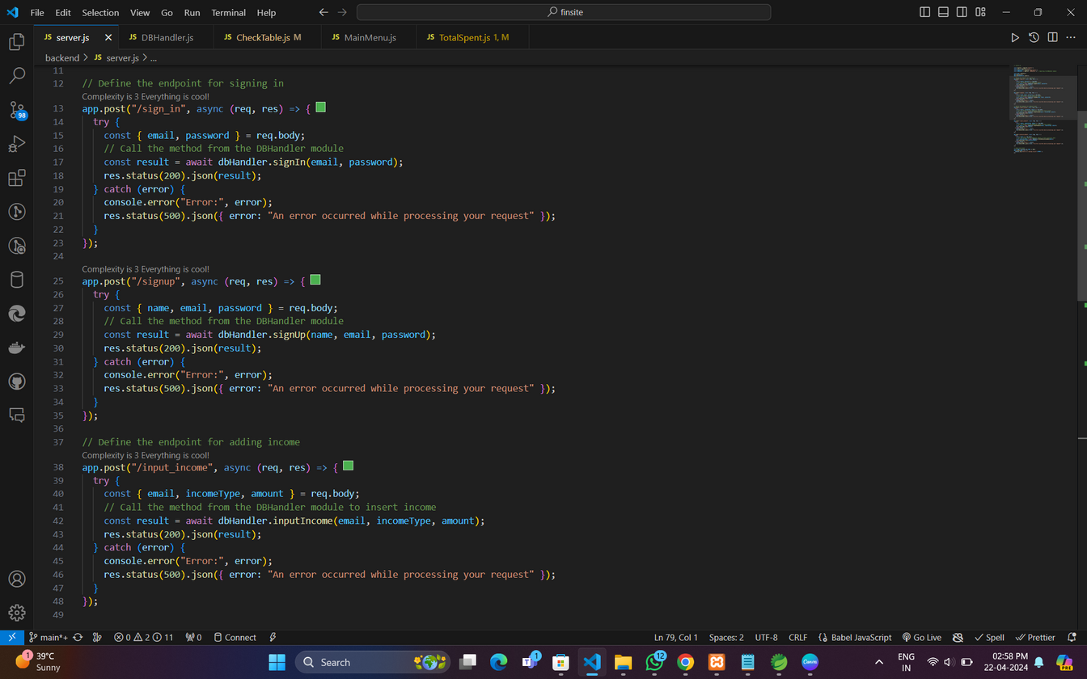
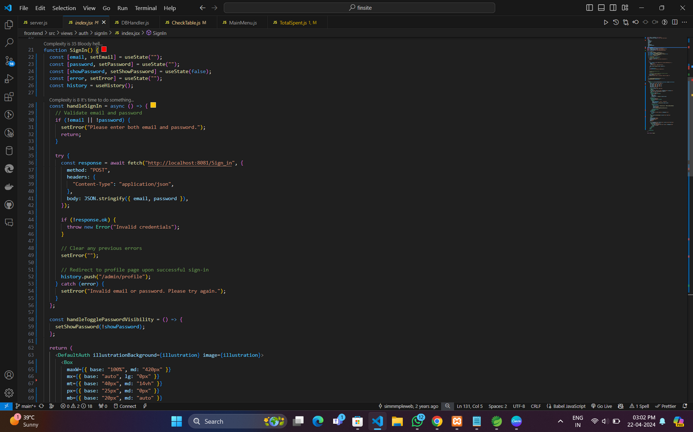
Source Code
Samples for server-Database connection
using Fetch-api
16

Slide 18
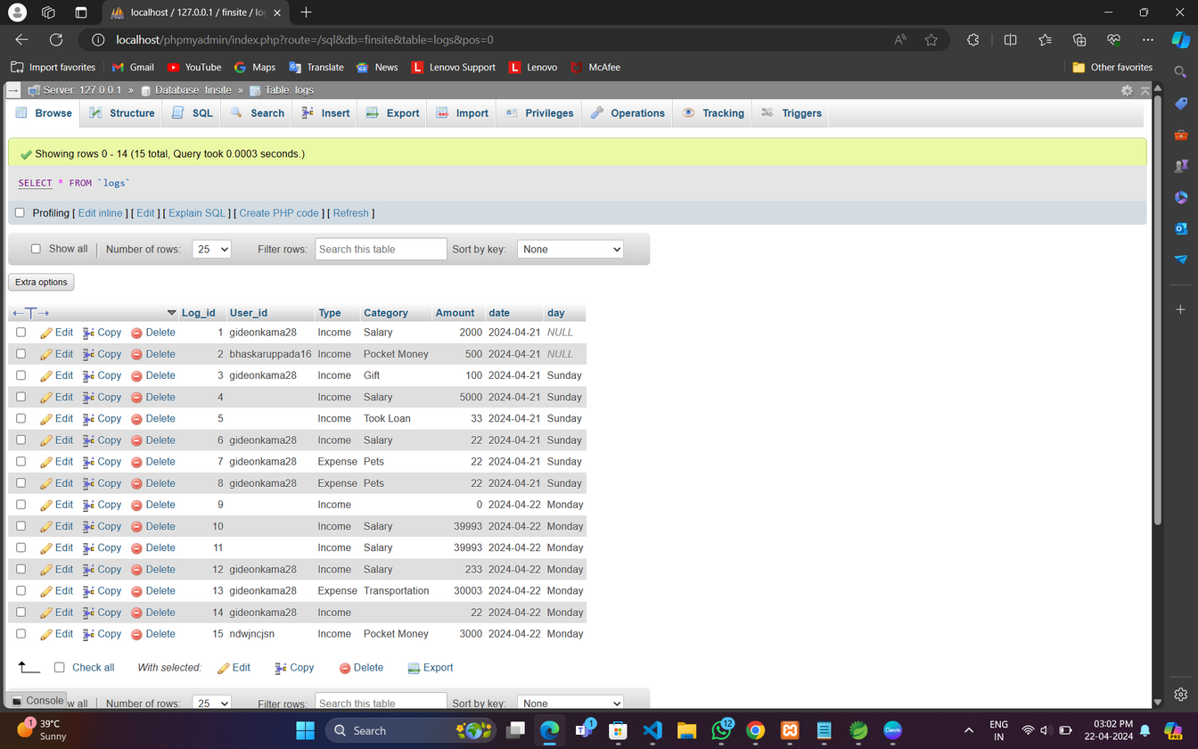
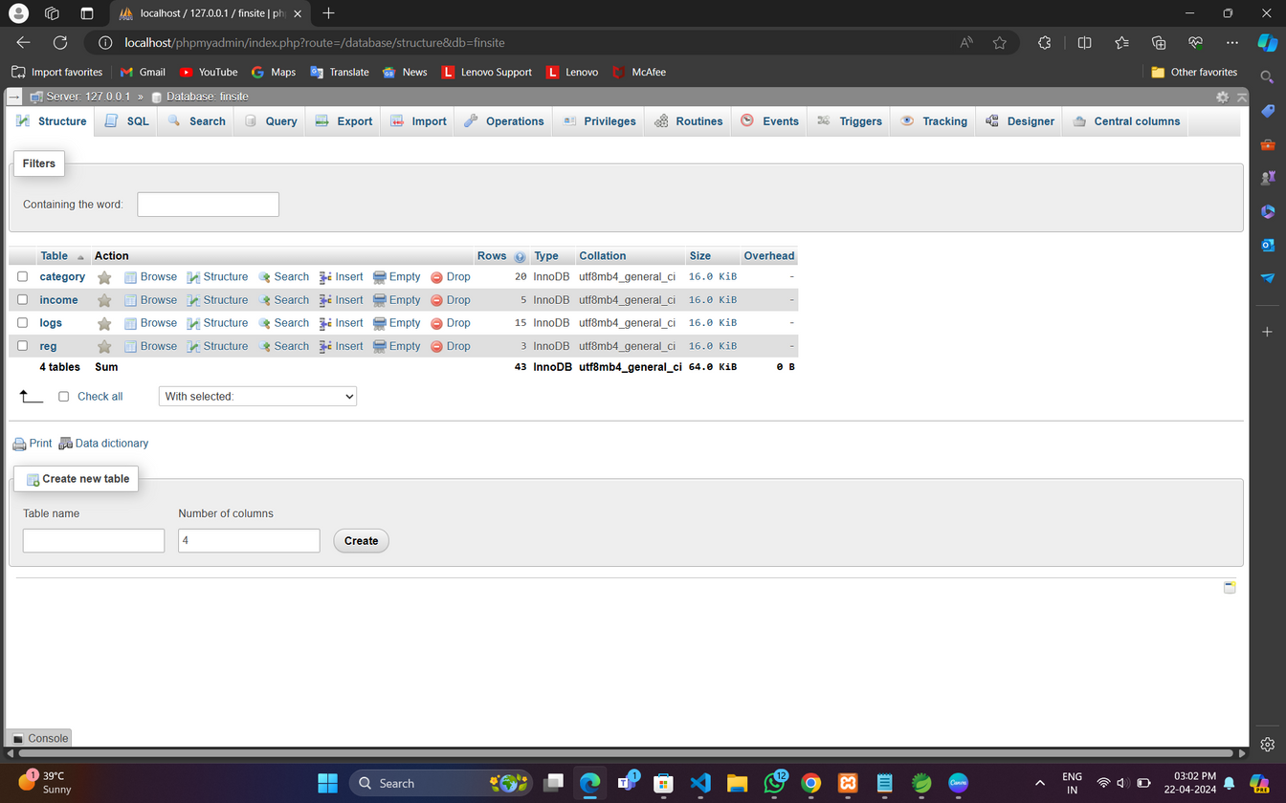
Database
Tables
Table Records
17

Slide 19
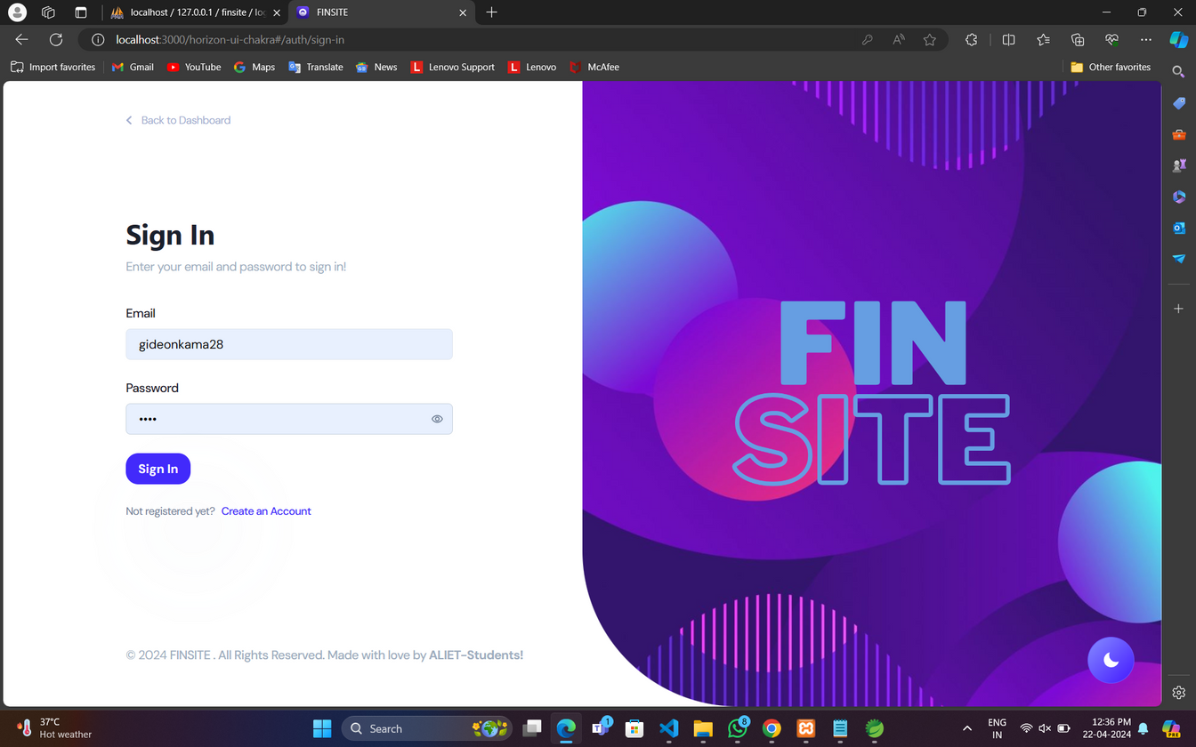
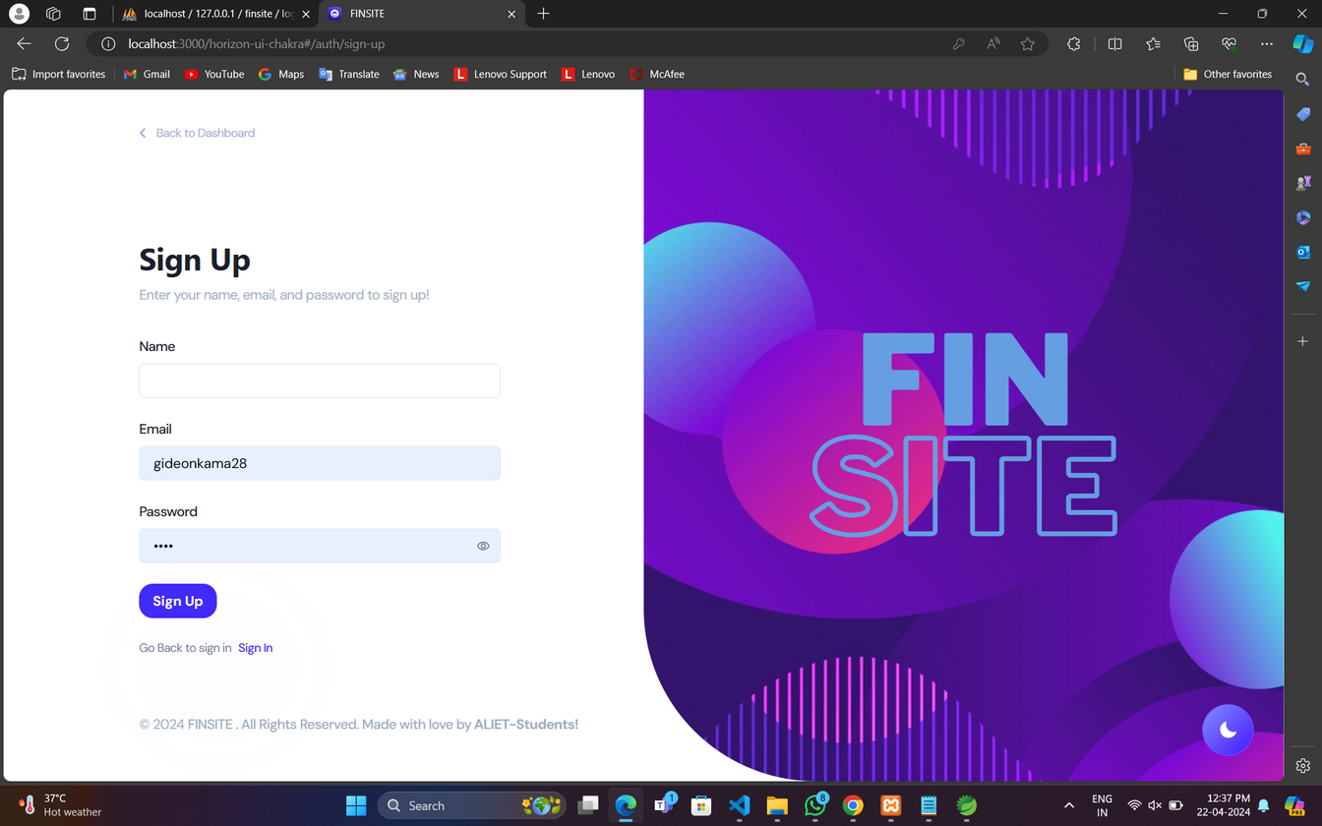
Sign In and
Sign UP
18

Slide 20
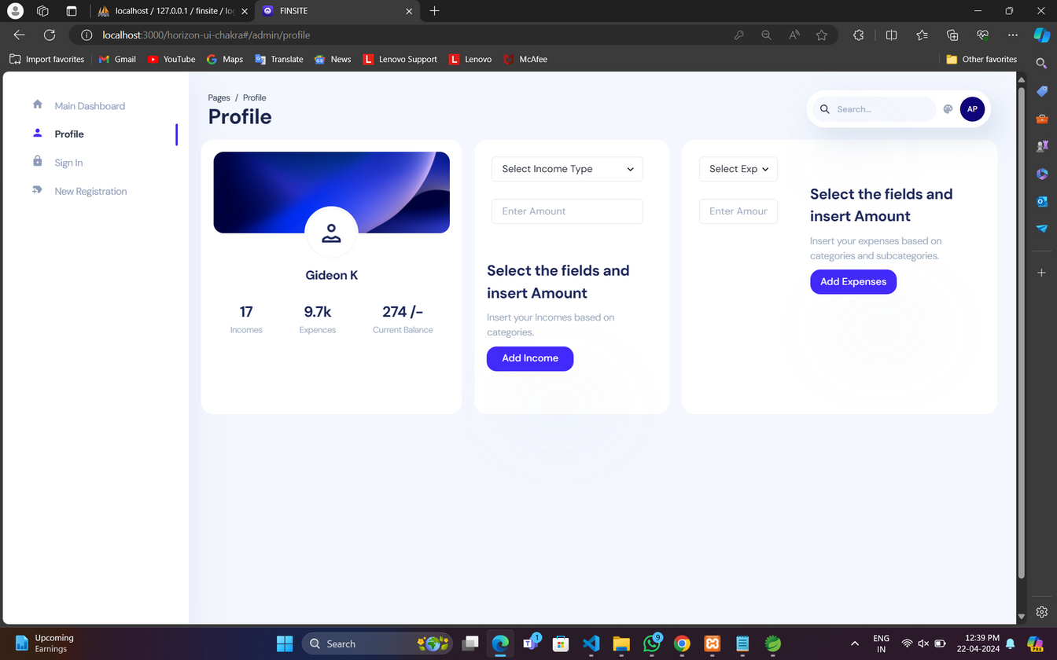
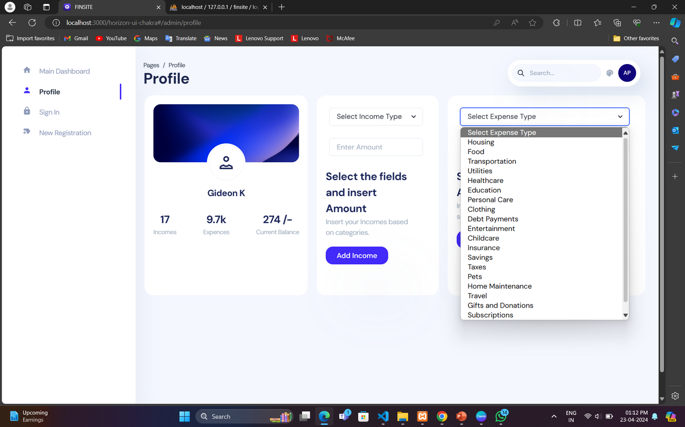
Profile, Income and Expense
19

Slide 21
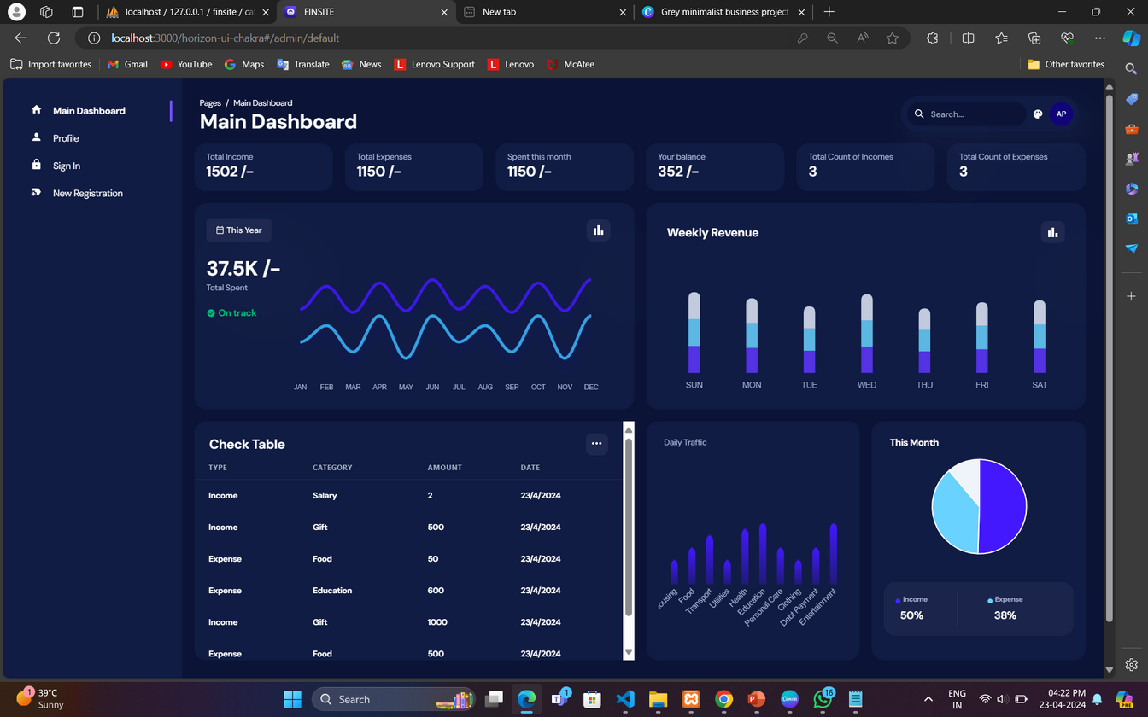
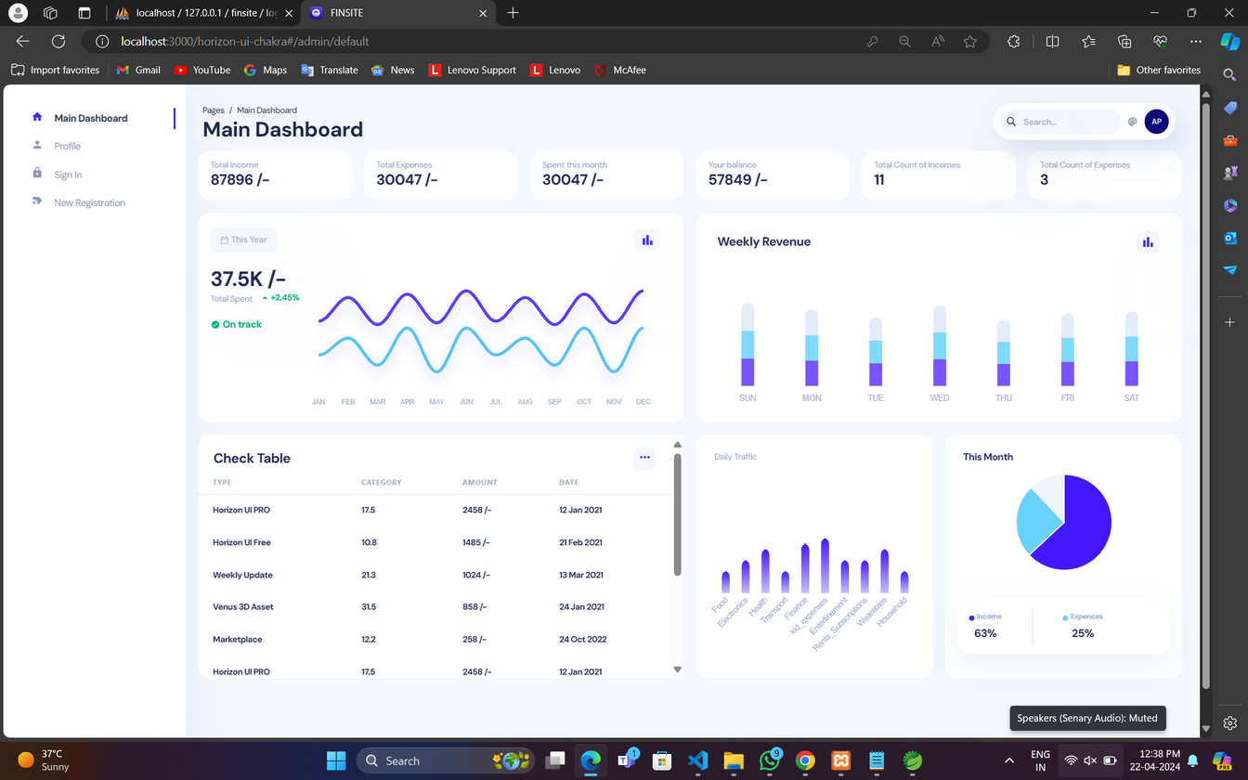
Dashboard
20

Slide 22
Conclusion
FinSight transforms personal finance management, offering a user-friendly interface and comprehensive features tailored to modern needs. With diverse expense categories, real-time updates, and customizable reports, FinSight empowers users to navigate their financial landscape with confidence and ease. Experience a new level of financial control with FinSight, reshaping the way individuals manage their money.
21

Slide 23
Reference
Sabab, Shahed Anzarus, et al. "Expense: A Smart Approach to Track Everyday Expense." 2018 4th International Conference on Electrical Engineering and Information and Communication, pp. 136-141, 2018.
Kimbrough, Michael D., et al. "SQL Databases for Expense Tracking: Benefits and Challenges." Journal of Financial Software, vol. 3, no. 1, pp. 45-58,2017.
Levion, M., et al. "SQL Database Design and Expense Tracking: A Case Study." International Journal of Database Management, vol. 6, no. 4, pp. 56-68, 2018.
Chen, L., et al. Mobile Expense Tracking Applications: SQL and XML Integration." Mobile Computing Journal, vol. 12, no. 3, pp. 421 436, 2019.
Albrecht, Conan C., Douglas L. Dean, and James V. Hansen. "Marketplace and Technology Standards for B2B E-Commerce: Progress, Challenges, and the State of the Art." Information and Management, vol. 42, no. 6, pp. 865-875, 2005.
22

Slide 24

Thank You!

